Slide 1
Introduction to Data Science Data Mining for Business Analytics
Brian d’Alessandro
VP – Data Science, Dstillery
Adjunct Professor, NYU
Fall 2014
Fine Print: these slides are, and always will be a work in progress. The material presented herein is original, inspired, or borrowed from others’ work. Where possible, attribution and acknowledgement will be made to content’s original source. Do not distribute, except for as needed as a pedagogical tool in the subject of Data Science.
Notes:
https://www.youtube.com/watch?v=aMDe5pODkB0 (harlan harris)

Slide 2
clustering
Notes:
The goal of finding structure is to information from one source to reduce uncertainty about another source.
What does this mean? Conditional distribution example. I.e., carnival guy who guesses your weight. If I can see your height I can reduce uncertainty about weight.
Find some height/weight data.
Under supervised exploration:
How can we (automatically) obtain a selection of the more informative variables with respect to predicting the value of the target variable?
Even better, can we obtain the ranking of the variables?
Can think of importance as one that makes the target variable more pure. This leads to the notion of entropy.

Slide 3
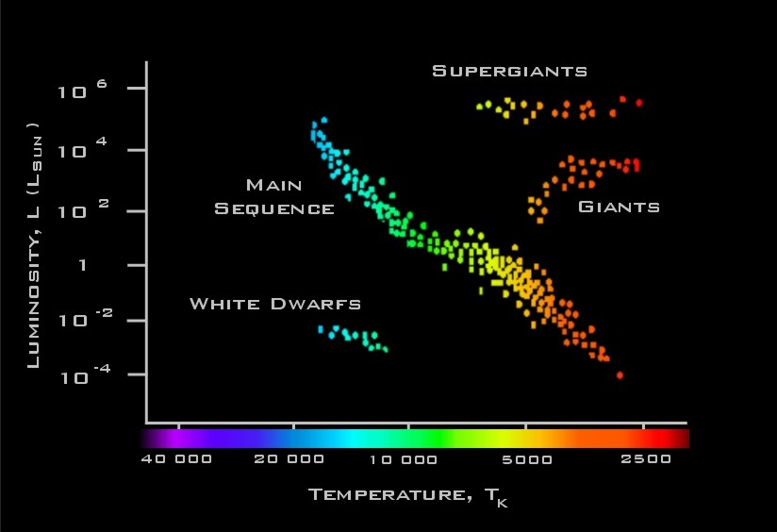
Hertzsprung-Russell Diagram
Notes:
Early 20th century; scientists were trying to understand different sorts of distant heavenly bodies based on data on them
(Wikipedia: The effective temperature of a body such as a star or planet is the temperature of a black body that would emit the same total amount of electromagnetic radiation.[1] Effective temperature is often used as an estimate of a body's temperature when the body's emissivity curve (as a function of wavelength) is not known.)
fusing hydrogen in main sequence
vs. fusing helium, burning hydrogen
-> relationship between T & L is about the same within clusters, but different between clusters
-→ how might you do something like this automatically (with many variables)?

Slide 4
Basic clustering goal
How do I find distinct groupings of similar objects?
An object is an row in a data matrix X with a feature vector X_{i}
Notes:
Early 20th century; scientists were trying to understand different sorts of distant heavenly bodies based on data on them
(Wikipedia: The effective temperature of a body such as a star or planet is the temperature of a black body that would emit the same total amount of electromagnetic radiation.[1] Effective temperature is often used as an estimate of a body's temperature when the body's emissivity curve (as a function of wavelength) is not known.)
fusing hydrogen in main sequence
vs. fusing helium, burning hydrogen
-> relationship between T & L is about the same within clusters, but different between clusters
-→ how might you do something like this automatically (with many variables)?

Slide 5
Basic clustering goal
Compute similarity/distance between objects
Create distinct groups that minimize intra-group distance and maximize inter-group distances
Notes:
Early 20th century; scientists were trying to understand different sorts of distant heavenly bodies based on data on them
(Wikipedia: The effective temperature of a body such as a star or planet is the temperature of a black body that would emit the same total amount of electromagnetic radiation.[1] Effective temperature is often used as an estimate of a body's temperature when the body's emissivity curve (as a function of wavelength) is not known.)
fusing hydrogen in main sequence
vs. fusing helium, burning hydrogen
-> relationship between T & L is about the same within clusters, but different between clusters
-→ how might you do something like this automatically (with many variables)?

Slide 6
2 techniques
K-Means (partitioning)
Clusters are defined by a center point
# groupings chosen in advance
Each object belongs to cluster in which it has minimum distance to cluster center
Generally cheaper, but not stable
Hierarchical
Clusters are arranged in a nested taxonomy
K can be chosen after the fact
Stable but computationally expensive

Slide 7
K-Means
1. Start with data and a predefined number of clusters, k.
2. Choose k seeds randomly.
Seeds

Slide 8
Assign Instances to Clusters
3. Assign each instance to the cluster for which it is closest to the cluster center.

Slide 9
Find New Centroids
4. Compute new centroids per cluster, which is the avg coordinate for all objects within the cluster.

Slide 10
Define new cluster
5. Repeat steps 3-4 until cluster centroids converge
Demo:
http://home.dei.polimi.it/matteucc/Clustering/tutorial_html/AppletKM.html

Slide 11
Kmeans discussion
Most common distance metric is Euclidean distance, but others are appropriate
Many rules from k-NN apply here
Scaling of features matters
Can up-weight important features
Features need to be numeric
What is the difference between k in k-means and k-nn?
Assessment
What is best k?
Is this a good fit?
What do the clusters mean?

Slide 12
Cluster hierarchy
Clusters can be embedded in other clusters. Hierarchical clustering attempts to uncover this embedding.
Notes:
Early 20th century; scientists were trying to understand different sorts of distant heavenly bodies based on data on them
(Wikipedia: The effective temperature of a body such as a star or planet is the temperature of a black body that would emit the same total amount of electromagnetic radiation.[1] Effective temperature is often used as an estimate of a body's temperature when the body's emissivity curve (as a function of wavelength) is not known.)
fusing hydrogen in main sequence
vs. fusing helium, burning hydrogen
-> relationship between T & L is about the same within clusters, but different between clusters
-→ how might you do something like this automatically (with many variables)?

Slide 13
Generic algorithm
This is the generic algorithm for agglomerative clustering methods.
Compute all pairwise similarities
Place each instance into its own cluster
Merge the two most similar clusters into one
Replace two clusters into the new cluster
Recompute intercluster similarity scores
Repeat until there are only k clusters left

Slide 14
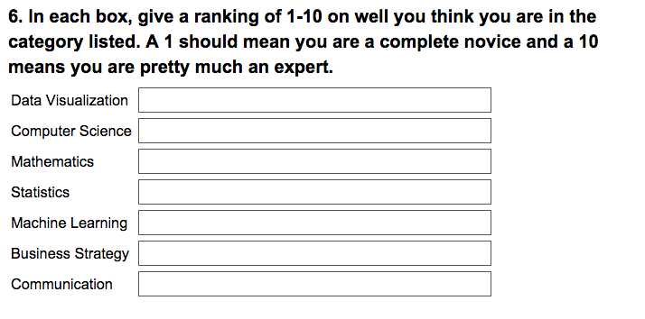
example
In our first homework all students filled out a DS profile self-assessment

Slide 15
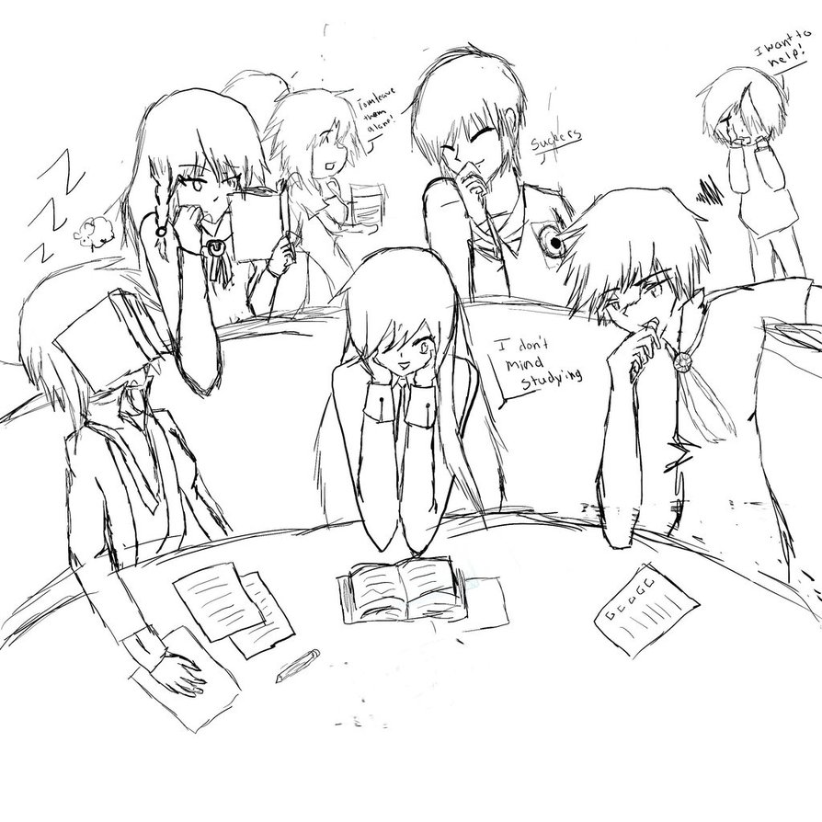
application
Goal :assign students into study groups of size 4, where each study group is maximally diverse with respect to skill distribution
We’ll use cluster analysis to segments students into roughly equal sized groups. We’ll also attempt to qualify each group.

Slide 16
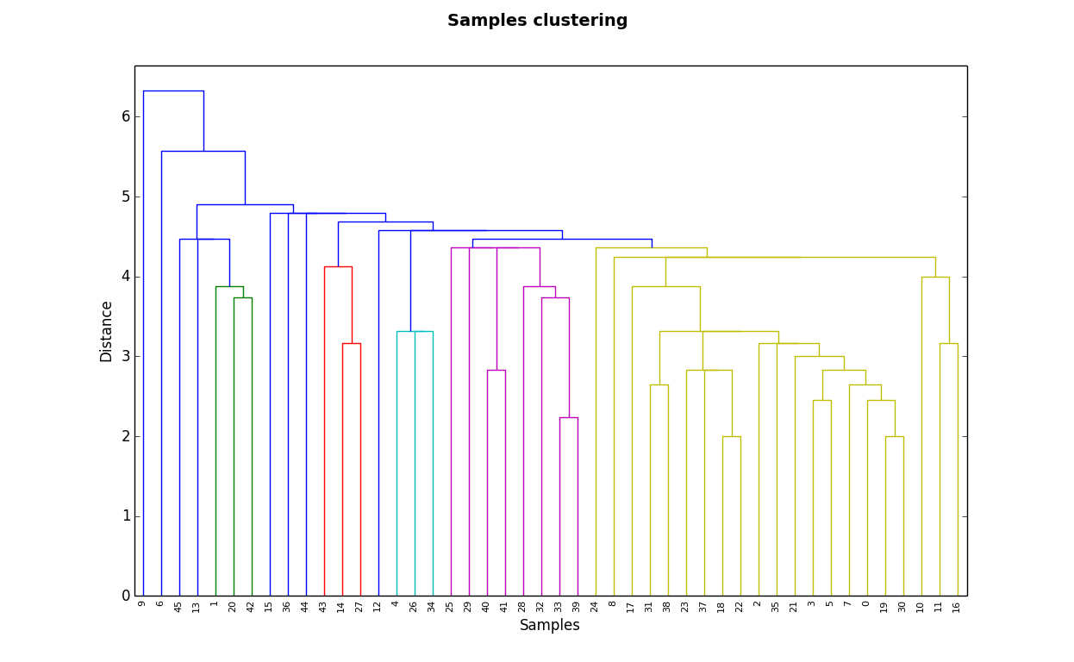
dendrogram
Hierarchical clustering gives us the opportunity to plot the nested nature of the clusters. We can use the dendrogram to spot outliers or determine k.

Slide 17
Using the dendrogram
We can use the dendrogram to cut the space into k clusters based on: distance or size
Distance based cut
Size based cut

Slide 18
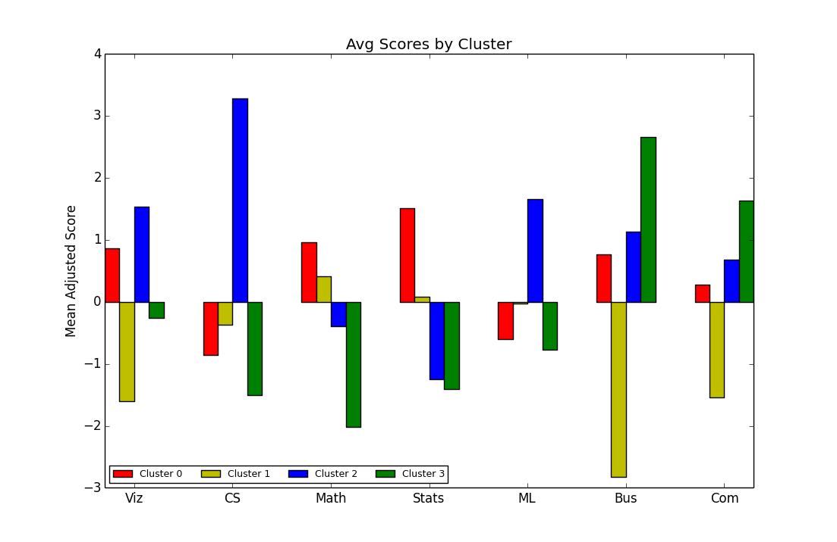
Explaining clusters
We look at the mean adjusted centroid of each cluster to get a sense of what/who the cluster describes.

